Slide 1
Slot 01: Introduction to PFC
Languages and C Compilers
First Program in C

Slide 2
Objectives
This chapter supplies basic concepts in computer programming. After studying this chapter, you should be able to:
Define concepts: computer program, computer software, Information, data, fundamental Data Units, data address
Explain how to make a good software?
Understand steps to develop a software?
Explain ways to represent data
Answer why C is the first language selected
Understand how a C program can be translated and execute
Discuss about notable features of C
Understand a C program structure

Slide 3
Contents
Definitions: computer program, computer software
How to make a good software?
Steps to develop a software?
Computer hardware.
Information, Data, Fundamental Data Units
Data Representation
Addressing Information
Program Instructions
Languages
Translate and execute a program
Why C is the first language selected?
Some notable features of C
Structure of a simple C Program.

Slide 4
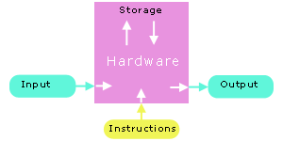
1.1- Definitions
Computer program:
A simulation of solution.
Is a set of instructions that computer hardware will execute
➔Increase performance of standard workflow (dòng công việc)
Computer software:
- A set of related programs
Pn
P1
P2
P3
Pn

Slide 5
1.2- How to make a good software?
Issues for a program/software:
Usability
robust and user-friendly interfaces
Correctness
comprehensive testing
Maintainability
Understandability
structured programming
internal documentation
Modifiability
standards compliance
Portability
standards compliance

Slide 6
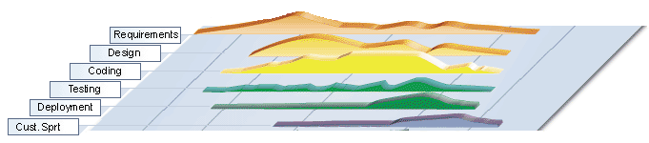
1.3- Steps to develop a software
Requirements
Analysis
Design
Coding
Testing
Deploying
Maintenance
Notes:
Yêu cầu
Phân tích
Thiết kế
Coding
Thử nghiệm
Triển khai
Bảo trì

Slide 7
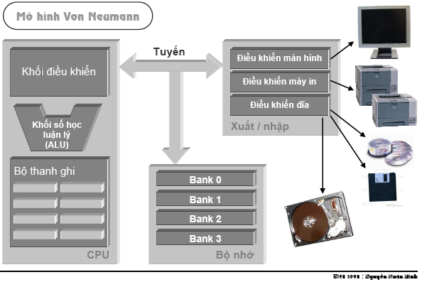
1.4- Computer Hardware - Review
3 bước giúp đọc 1 ô nhớ:
CPU áp đặt dữ liệu địa chỉ ô nhớ lên address bus
CPU áp đặt tín hiệu “đọc” lên control bus.
Data trong ô nhớ sẽ theo data bus về 1 thanh ghi của CPU.
Bus | Used to
Address bus | Determine the IO peripherals, position of accessed memory.
Data bus | Transmit data
Control bus | Determine operation on peripherals, read peripheral ‘s states

Slide 8
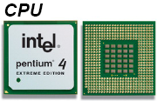
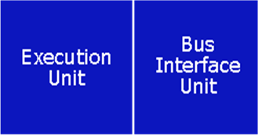
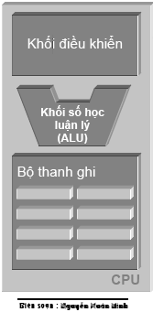
1.4- Computer Hardware…
The most expensive and fastest memory - registers - is reserved for the CPU.
CPU transfers information at less than 10 nanoseconds
primary memory transfers information at about 60 nanoseconds
a hard disk transfers information at about 12,000,000 nanoseconds
CPU memory is volatile - the contents of the registers are lost as soon as power is turned off.

Slide 9
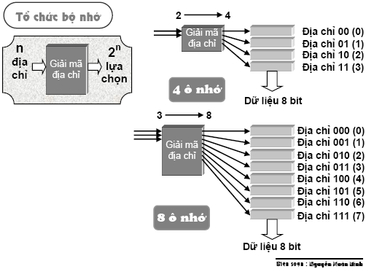
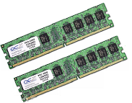
1.4- Computer Hardware…
Primary Memory
Primary memory holds the information accessed by the CPU.
Primary memory is also volatile.
The popular term for primary memory is RAM (Random Access Memory).

Slide 10
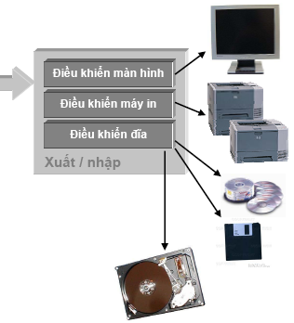
1.4- Computer Hardware…
Devices
Include I/O devices such as a keyboard, a monitor and a mouse…
Storage devices such as a floppy drive, a hard drive and a CD-ROM drive (secondary storage).
Each device interfaces with the system buses through a device controller.

Slide 11
1.4- Computer Hardware…
Devices
Include I/O devices such as a keyboard, a monitor and a mouse…
Storage devices such as a floppy drive, a hard drive and a CD-ROM drive (secondary storage).
Each device interfaces with the system buses through a device controller.

Slide 12
1.5- Information/Data
Data: specific values that describe something
Information: Meaning of data
Program information consists of instructions and data.
How is this information stored?
What does a program instruction look like?
How do we make program instructions readable?

Slide 13
1.6- Data Units
John von Neumann selected binary (base 2) digits as the EDVAC's fundamental unit.
The vast majority of modern computers process and store information in binary digits.
We call a binary digit a bit.
One nibble consists of 4 consecutive bits.
The fundamental addressable unit of primary memory is the byte → One byte consists of 2 nibbles.
Byte
Nibble |  |  |  | Nibble
Bit | Bit | Bit | Bit | Bit | Bit | Bit | Bit
00000000 <- possibility 0 00000001 <- possibility 1 00000010 <- possibility 2 00000011 <- possibility 3 00000100 <- possibility 4 ... 00111000 <- possibility 104 ... 11111111 <- possibility 255

Slide 14
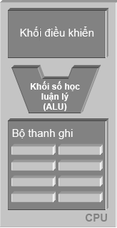
1.6- Data Units …
The natural unit of the CPU is a word. A word is the size of the general registers - the unit of memory within the CPU.

Slide 15
1.7- Data Representations
3 common number systems:
Decimal Representation
Hexadecimal Representation
Base 16: 0, 1, …, 9, A, B, C, D, E, F
Each hexadecimal digit represents 4 bits of information.
The 0x prefix identifies the number as a hexadecimal number: 0x5C
Octal Representation
Base 8: 0, 1, 2, .., 7
Set of 3 consecutive bits forms an octal digit
The prefix 0 identifies the number as an octal number: 031

Slide 16
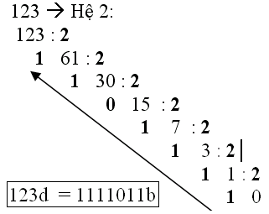
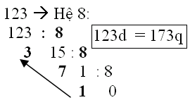
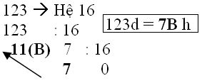
Data Representations: Conversion- A review
Read by yourself

Slide 17
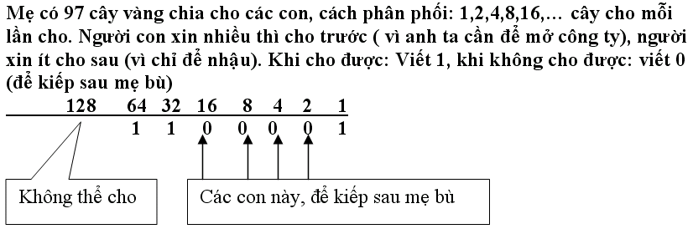

Data Representations: Conversion: A review
Read by yourself

Slide 18
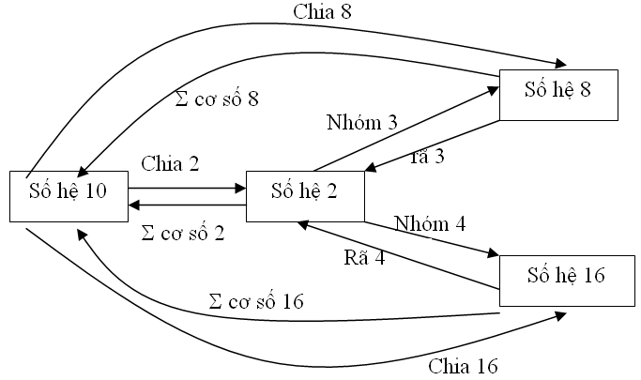
Data Representations: Conversion: A review
Read by yourself

Slide 19
Data Representations: Conversion…
Read by yourself
Máy tính là thiết bị nhị phân nên tất cả mọi dữ liệu đều được lưu trữ dạng nhị phân.
Giải mã sang dạng biểu diễn của người
3
Số quả dâu:
3
Mã hóa
00110011
Dạng mô tả của người
3

Slide 20
Data Representations: Conversion…
Fill the corresponding binary expansions of the following decimal number:
Decimal | 4-bit Binary | Decimal | 8-bit Binary | Decimal | 16-bit Binary
9 | 1001 | 7 | 0000 0111 | 255 | 0000 0000 1111 1111
7 |  | 34 |  | 192
2 |  | 125 |  | 188
15 |  | 157 |  | 312
12 |  | 162 |  | 517
11 |  | 37 |  | 264
6 |  | 66 |  | 543
5 |  | 77 |  | 819
8 |  | 88 |  | 1027
13 |  | 99 |  | 2055
14 |  | 109 |  | 63
Read by and do yourself

Slide 21
Data Representations: Conversion…
Read by yourself
Fill the blank cells
Decimal | Binary | Hexa. | Decimal | 16-bit Binary | Hexadecimal
9 | 1001 | 9 | 255 | 0000 0000 1111 1111 | 00FF
127 | 0111 1111 | 9F | 192
125 |  |  | 188
157 |  |  | 312
162 |  |  | 517
37 |  |  | 264
66 |  |  | 543
77 |  |  | 819
88 |  |  | 1027
99 |  |  | 2055
109 |  |  | 63

Slide 22
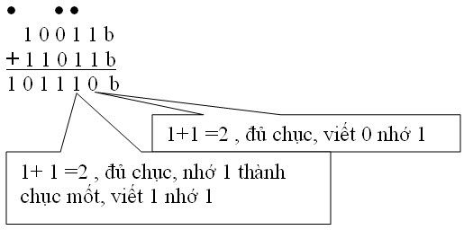
Data Representations: Operations
Read by yourself
Do yourself:
3245q + 247q
1A7Bh + 26FE7h
101101111 b
100111011 b
110110001 b
110001101b
+

Slide 23
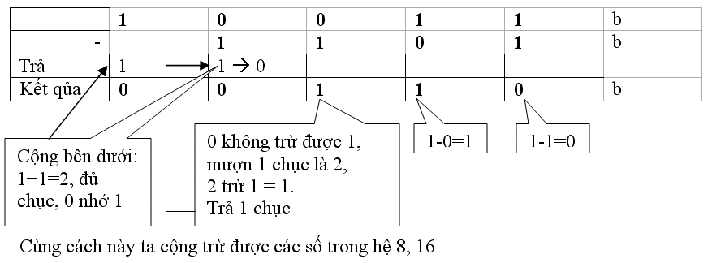
Data Representations: Operations …
Read by yourself
Do yourself
1101101101b - 10110111b 3654q – 337q 3AB7h – 1FAh
36Ah – 576q = ? h 64AEh – 1001101b= ? q

Slide 24
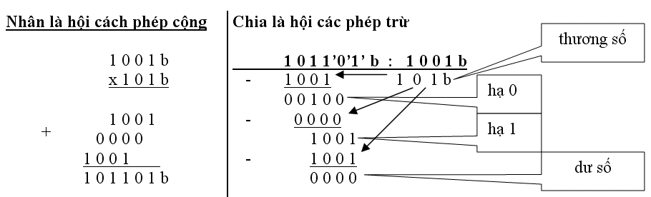
Data Representations: Operations …
Read by yourself
Bài tập : Làm các phép tính
1011010 b* 1011b
1101000b + 2AB h + 345 q = ? h = ? q
3AFh / 1Ch =? b = ?d
3ACh – 562q = ?b = ? d
3FFA h / 327q = ?b = ? d

Slide 25
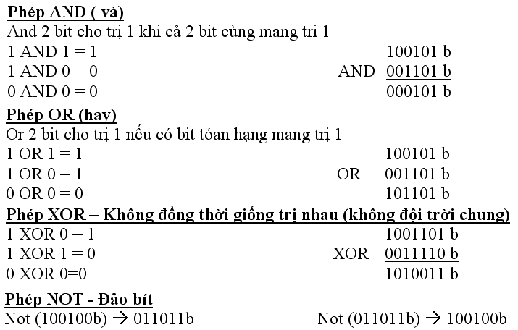
Data Representations: Operations …
Read by yourself

Slide 26
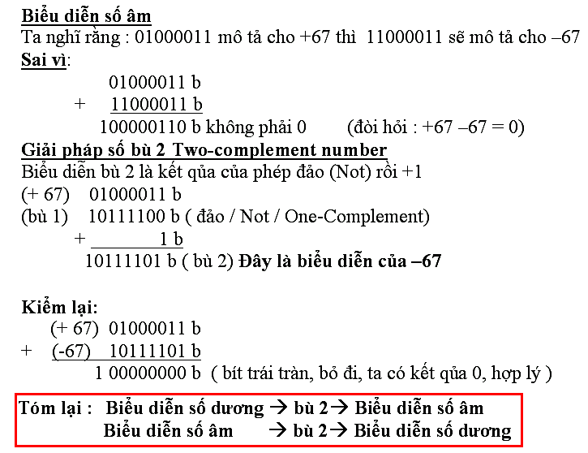
Data Representations: Signed Integers
Dùng
bit trái (leftmost bit) để mô tả dấu:
0:positive, 1:negative
Read by yourself

Slide 27
Data Representations: Signed Integers
Read by yourself
Tìm biểu diễn của –35 với 1 byte
Cách làm: Ta tìm biểu diễn của +35 rồi tìm bù 2 của nó ta được biểu diễn số âm
Tìm trị của biểu diễn số nguyên có dấu 1 byte 11111100 b
Bít trái : 1 → Biểu diễn số âm. Nếu ta tìm được biểu diễn dương tương ứng, tìm trị , thêm dấu trừ ta được trị kết qủa.
Bài tập
Tìm biểu diễn của số nguyên không dấu 1 byte: 251 , 163, 117
Tìm biểu diễn của số nguyên không dấu 2 byte: 551 , 160, 443
Tìm biểu diễn của số có dấu 1 byte: -51 , -163, -117, 320
Tìm trị của biễu diễn số nguyên có dấu 1 byte :
01100011 b , 10001111 b , 11001010 b , 01001100 b

Slide 28
1.8- Addressing Information
Each byte of primary memory has a unique address, start from zero
Kilobyte = 1024 bytes
Kilo K= 1024 ( 2¹⁰)
Mega or M (=1024k)
Giga or G (=1024M)
Tera or T (=1024G)
Peta or P (=1024T)
Exa or E (=1024P)
Addressible Memory
The maximum size of addressable primary memory depends upon the size of the address registers
 | MEMORY
… | …….
5 | 1010 1010
4 | 0011 1100
3 | 0101 0100
2 | 1001 0000
1 | 1100 1011
0 | 0100 0001
B: byte
b: bit

Slide 29
1.9- Program Instructions
01001011 | 100110110110 | 011011010111
Opcode | Operand 1 | Operand 2
Each program instruction consists of an operation and operands
The CPU performs the operation on the values stored as operands or on the values stored in the operand addresses.
Operands: Constants, registers, primary memory addresses

Slide 30
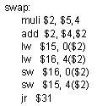

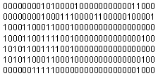
1.9- Program Instructions…
High-level language code
Assembly
(low-level)
code
Machine (binary)
code
compiler
assembler

Slide 31
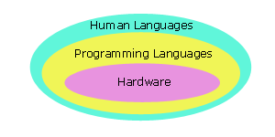
1.10- Programming Languages
Programs that perform relatively simple tasks and are written in assembly language contain a large number of statements.
Machine Language → Assembly language → High-level languages,
To make our programs shorter, we use higher-level languages.

Slide 32
1.10- Programming Languages…
5 Generations of Programming Languages:
(1) Machine languages.
(2) Assembly languages.
(3) Third-generation languages. These are languages with instructions that describe how a result is to be obtained (C, Pascal, C++, Java…).
(4) Fourth-generation languages. These are languages with instructions that describe what is to be done without specifying how it is to be done (SQL).
(5) Fifth-generation languages are the closest to human languages. They are used for artificial intelligence, fuzzy sets, and neural networks (Prolog, Matlab)

Slide 33
1.10- Programming Languages…
The higher the level, the closer to the human languages and the further from native machine languages
Each third generation language statement ~ 5-10 machine language statements.
Each fourth generation language ~ 30-40 machine language statements.

Slide 34
1.11- Translate and Execute a Program
When we code a program in a high level language, we write source code. We translate this code into machine language.
2 ways of translations:
Interpreting: Translate and execute statements one-by-one → Interpreter
Compiling: Translate all the program then execute all the program → Compiler
C translator is a compiler

Slide 35
1.12- Why C is the 1st Language?
C is one of the most popular languages in use globally
Some reasons for learning programming using the C language include:
Language | Time to Run
Assembly | 0.18 seconds
C | 2.7 seconds
Basic | 10 seconds
Comparative times for a Sieve of Eratosthenes test
C is English-like,
C is quite compact - has a small number of keywords,
A large number of C programs need to be maintained,
C is the lowest in level of the high-level languages,
C is faster and more powerful than other high-level languages,
The UNIX, Linux and Windows operating systems are written in C and C++.

Slide 36
1.13- Some Notable C Features
Comments
/* */
We use comments to document our programs and to enhance their readability. C compilers ignore all comments.
Whitespace
We use whitespace to improve program readability and to display the structure of our program's logic. C compilers ignore all whitespace
Case Sensitivity
C language is case sensitive.
C compilers treat the character 'A' as different from the character 'a' .

Slide 37

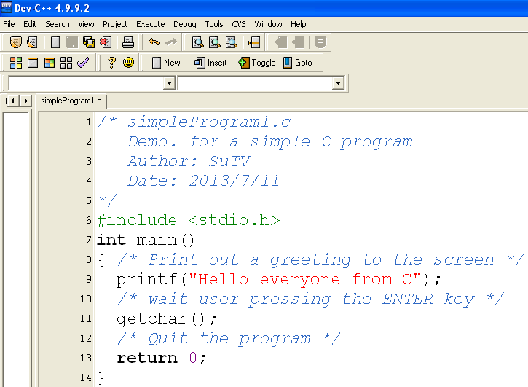

1.14- Structure of a Simple C Program
Comment for program description
Declaration for library using
Entry point of C-program
Statements + comments
Exit point of C-program

Slide 38
Structure…: C program Entry Points
Entry point: the point that a program begins.
Entry points of C-programs:
[int] main( [void] )
{ <statements>
[ return number; ]
}
Common form
[int] main( int argCount, char* args[])
{ <statements>
[ return number; ]
}
Demo.
In the module H (Files)

Slide 39
Summary
Definitions: computer program, computer software
How to make a good software?
Steps to develop a software?
Computer hardware.
Information, Data, Fundamental Data Units
Data Representation
Program Instructions
Languages
C Compilers
Why C is the first language selected?
Some notable features of C
Structure of a simple C Program.

